Slide 1

Assistant Professor
RAJIV GANDHI PROUDYOGIKI VISHWAVIDYALAYA,
BHOPAL (M.P.)
A Major Project Report on
FACIAL EMOTION ANALYSIS SYSTEM
Submitted By
Sameer Ansari (0827CS171187)
Shubham Chandrol (0875CS171207)
Tanish Verma (0875CS171223)
Guided By: Supervised By:
Ms. Nidhi Nigam Mr. Anil Patidar
Assistant Professor Assistant Professor
DEPARTMENT OF COMPUTER SCIENCE & ENGINEERING
AITR INDORE (M.P.) 452020
2019-2020

Slide 2
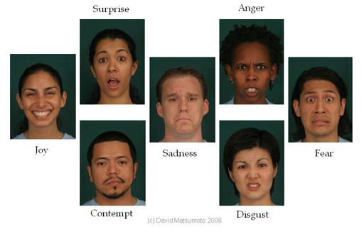
TITLE- FACE EMOTION ANALYSIS

Slide 3
INTRODUCTION
Facial emotions are important aspects in human communication that helps us to understand the intentions of others.
According to different surveys non-verbal components convey one-third of human communication.
Humans recognize facial emotions accurately without delay but for a machine it is a challenge.

Slide 4
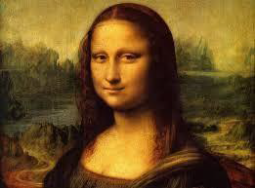
MOTIVATION
Significant debate has risen in past regarding the emotions portrayed in the world famous masterpiece of Mona Lisa. British Weekly “New Scientist” has stated that she is in fact a blend of many different emotions, 83%happy, 9% disgusted, 6% fearful,2% angry.

Slide 5

We have also been motivated observing the benefits of physically handicapped people like deaf people. But if any normal human being or an automated system can understand their needs by observing their facial expression then it becomes a lot easier for them to make the fellow human or automated system understand their needs.

Slide 6
REVIEW OF LITERATURE
Different Strengths & Weaknesses were noted in the emotion recognition system by Mr. Ashwini, Mr. Jacob and Dr. Jubilant [14] of St. Joseph’s College of Engineering.
Mr. Aruna Chakraborty, Mr. Amit Konar, Mr. Uday Kumar Chakraborty, and Mr. Amita Chatterjee in. Emotion Recognition from Facial Expressions and Its Control Using Fuzzy Logic [15] explained that this fuzzy approach that has accuracy of about 90%.
Strengths and weaknesses of facial expression classifiers and acoustic emotion classifiers were analyzed by Carlos Busso, Zhigang Deng, Serdar Yildirim, Murtaza Bulut, Chul Min Lee, Abe Kazemzadeh, Sungbok Lee, Ulrich Neumann and Shrikanth Narayanan. [1].
4. Facial Emotion Detection using CNN and Representiontal Autoencoders Units By Prudhvi Raj Dachpally,School of Informatics and Computing,Indiana University.

Slide 7
LITERATURE SURVEY
As per various literature surveys it is found that for implementing this project four basic steps are required to be performed.
Preprocessing
Face registration
Facial feature extraction
Emotion classification

Slide 8

TECHNOLOGY USED

Slide 9
Packages
Tensorflow:- Tensorflow is a free and open-source symbolic math library used for machine learning applications such as neural networks.
tflearn:- tflearn is a modular and transparent deep learning library built on top of tensorflow. It provides a higher-level API to tensorflow in order to facilitate and speed-up experimentations.
Keras:- Keras is a high-level neural networks API and capable of running on top of tensorflow, CNTK or Theano. It allows easy and fast prototyping.
Numpy:- It is a core library for scientific computing in python. It provides a high-performance multidimensional array object, and tools for workingwith these arrays.
Matplotlib:- It is a comprehensive library for creating static, animated, and interactive visualizations in python.

Slide 10
















Process Flow
Raw Image
Normalization
CNN Train
CNN
Weights
Fig1: Training Phase
CNN
Weights
Raw Image
Normalization
CNN
Facial Expression
Fig2: Testing Phase

Slide 11
Stochastic Gradient Descent(SGD)
The word ‘stochastic‘ means a system or a process that is linked with a random probability. Hence, in Stochastic Gradient Descent, a few samples are selected randomly instead of the whole data set for each iteration. In typical Gradient Descent optimization, like Batch Gradient Descent, the batch is taken to be the whole dataset. Although, using the whole dataset is really useful for getting to the minima in a less noisy or less random manner, but the problem arises when our datasets get really huge.
Suppose, you have a million samples in your dataset, so if you use a typical Gradient Descent optimization technique, you will have to use all of the one million samples for completing one iteration while performing the Gradient Descent, and it has to be done for every iteration until the minima is reached. Hence, it becomes computationally very expensive to perform.
This problem is solved by Stochastic Gradient Descent. In SGD, it uses only a single sample, i.e., a batch size of one, to perform each iteration. The sample is randomly shuffled and selected for performing the iteration.

Slide 12
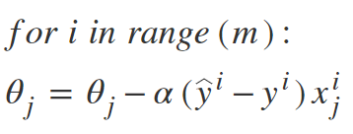
Algorithm

Slide 13
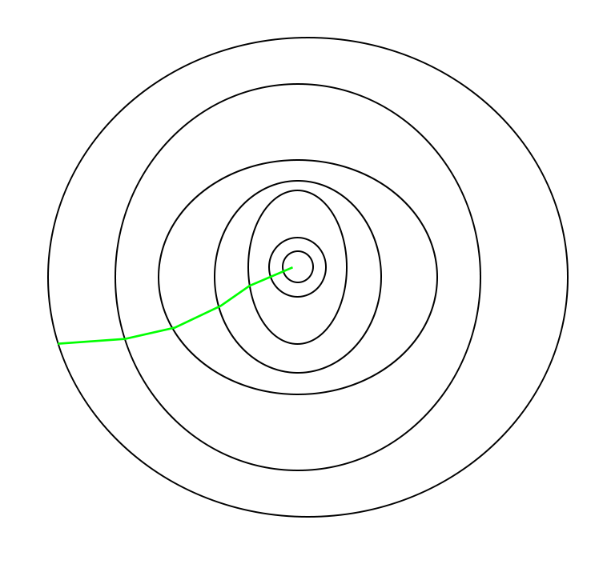
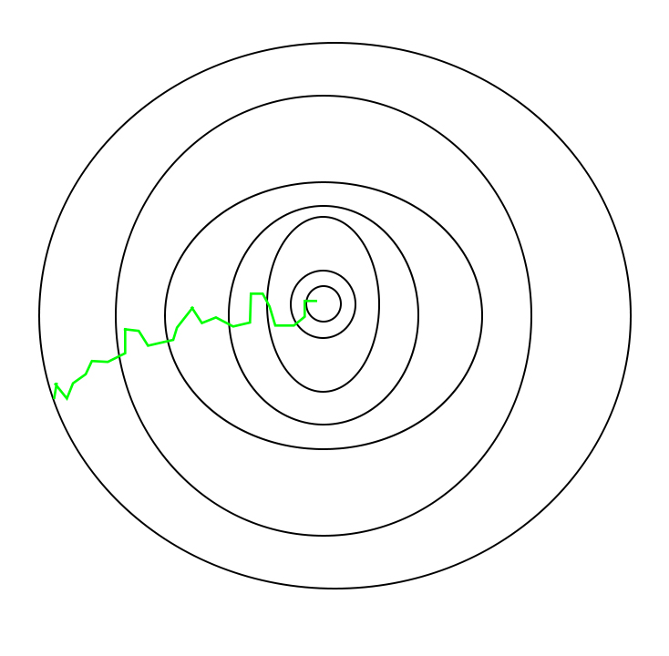
Path taken by batch and stochastic gradient descent

Slide 14

Code ScreenShots

Slide 15
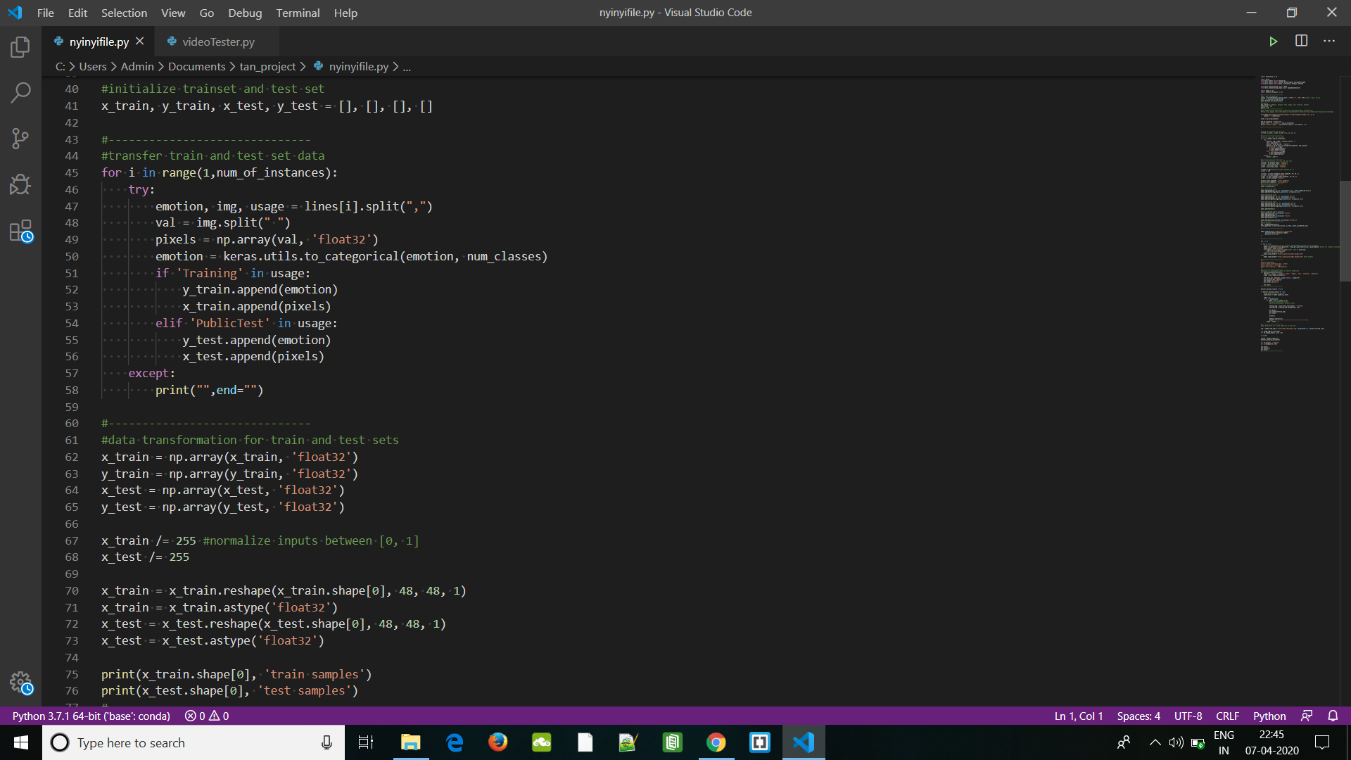

Slide 16
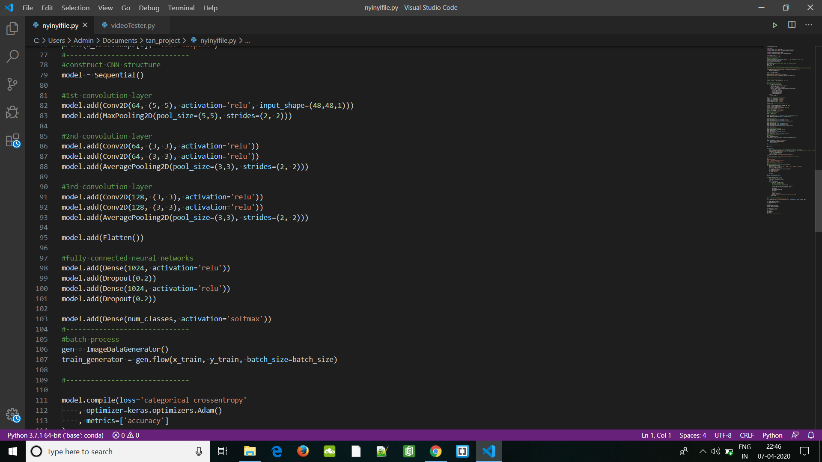

Slide 17
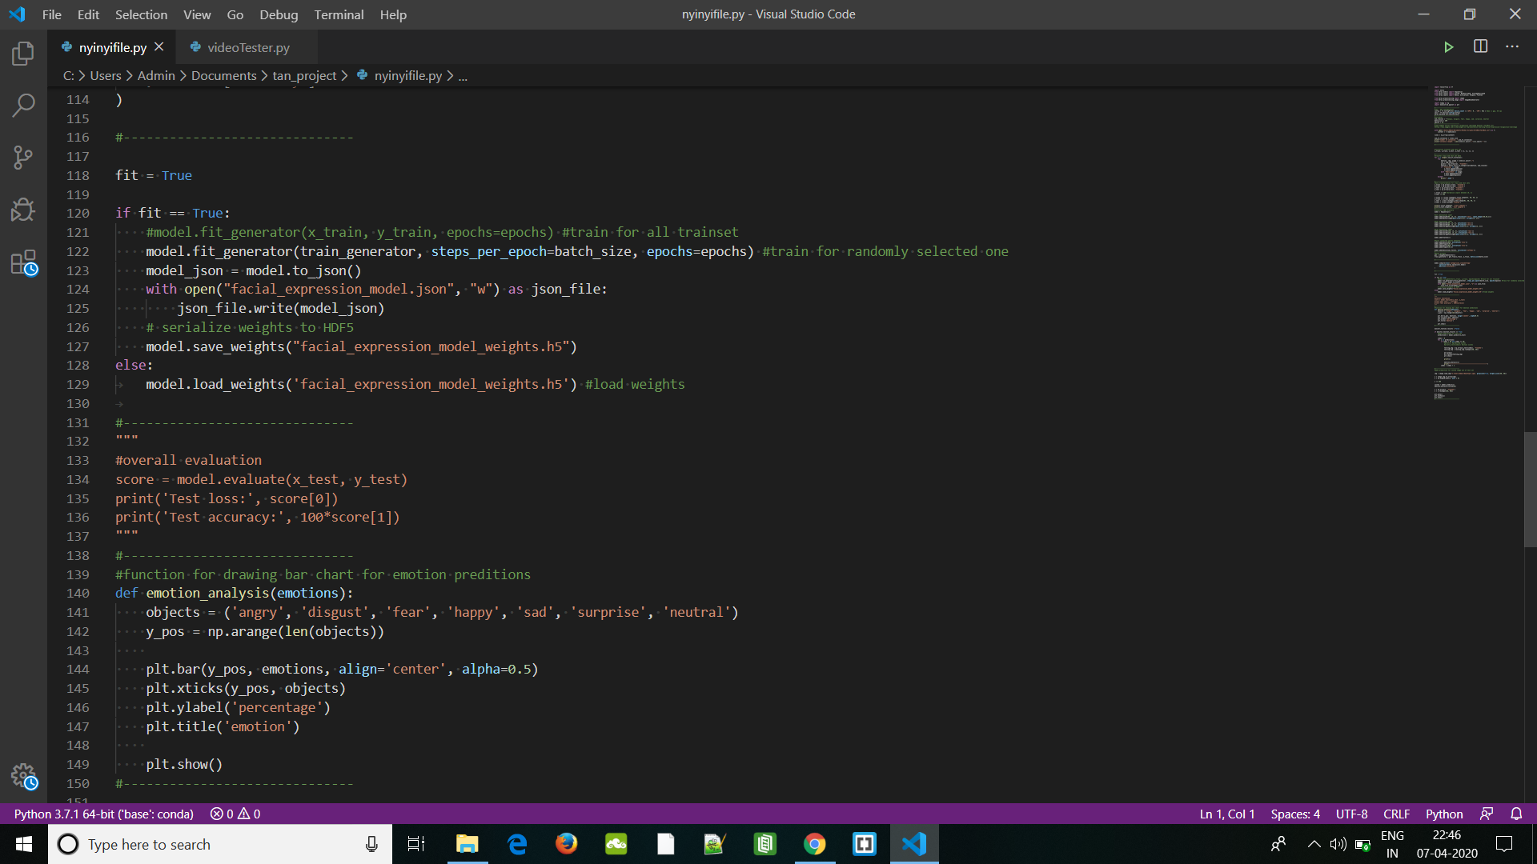

Slide 18
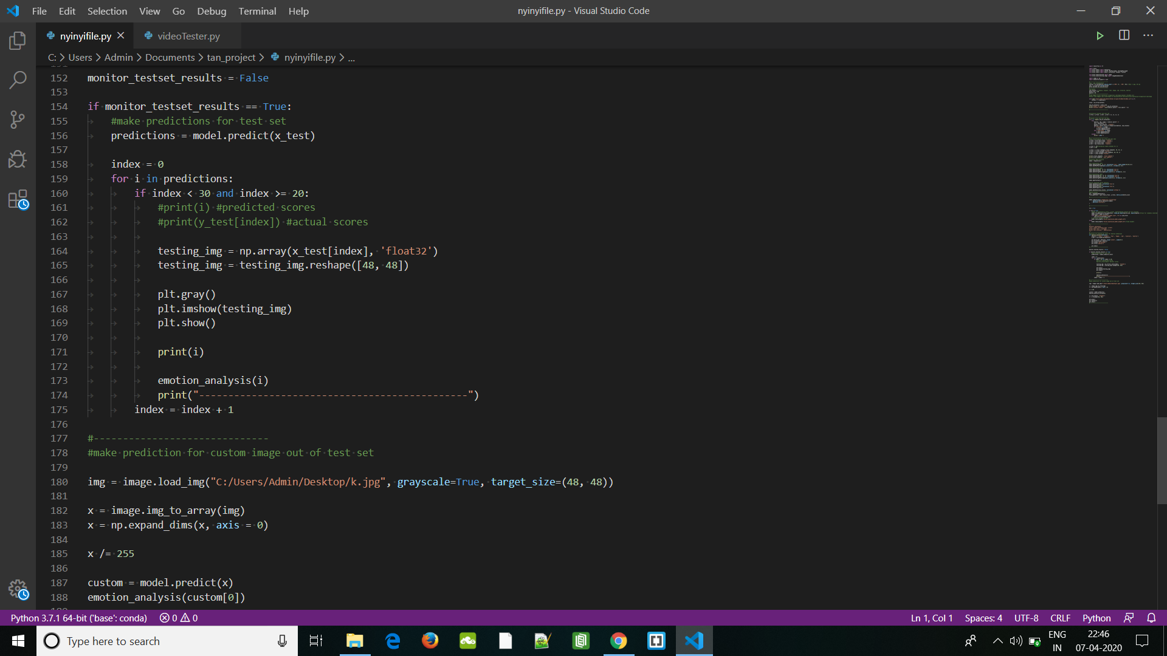

Slide 19
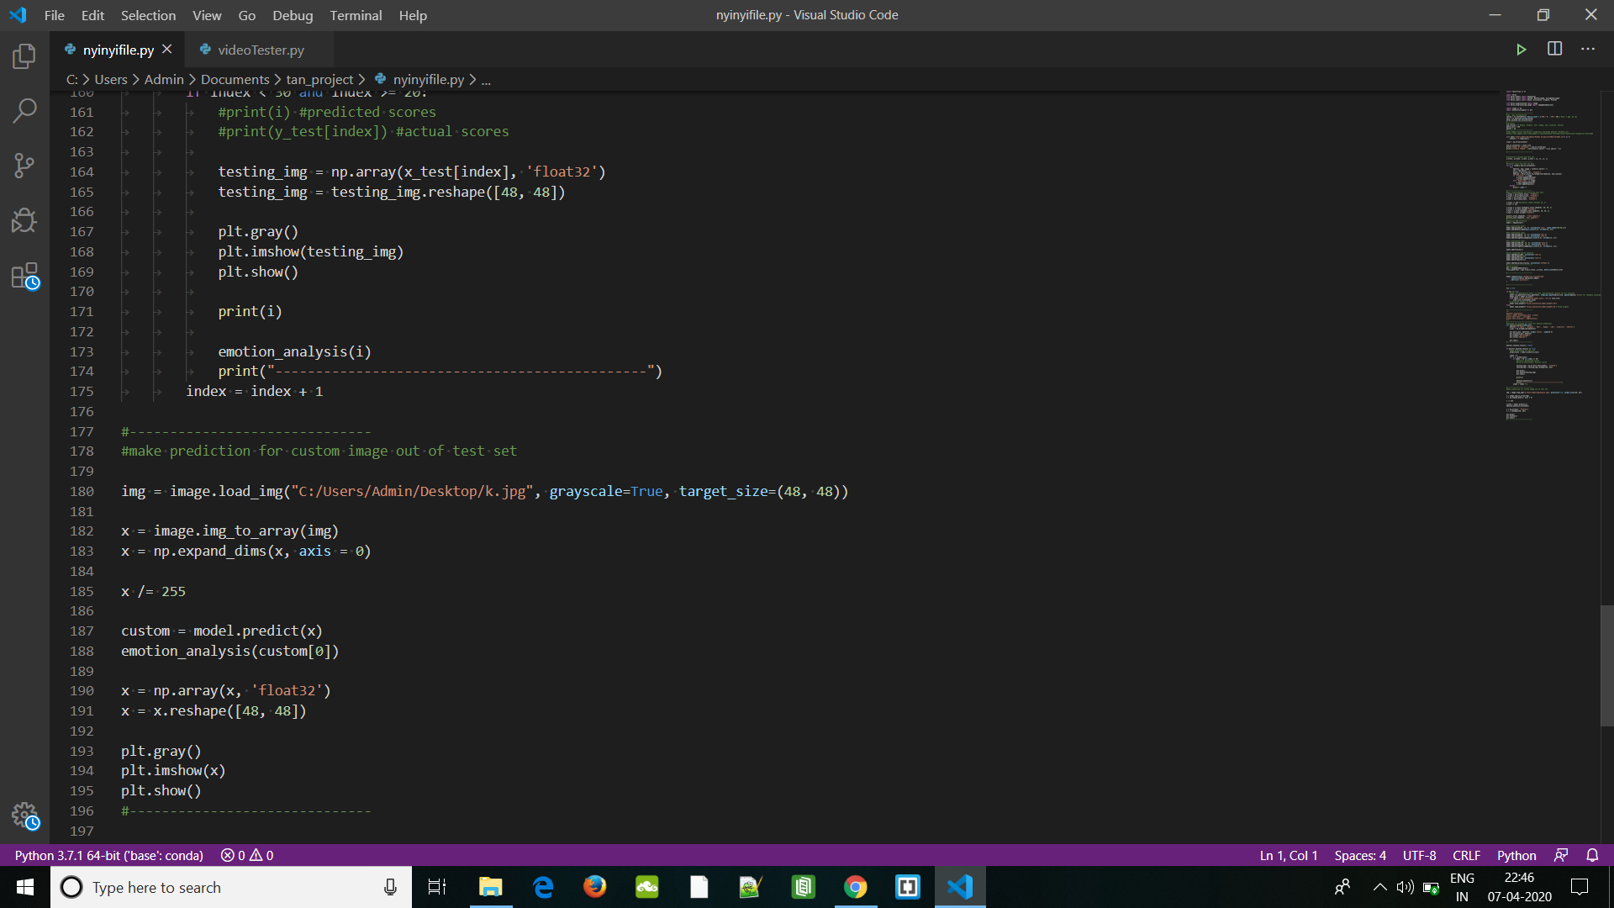

Slide 20


Slide 21
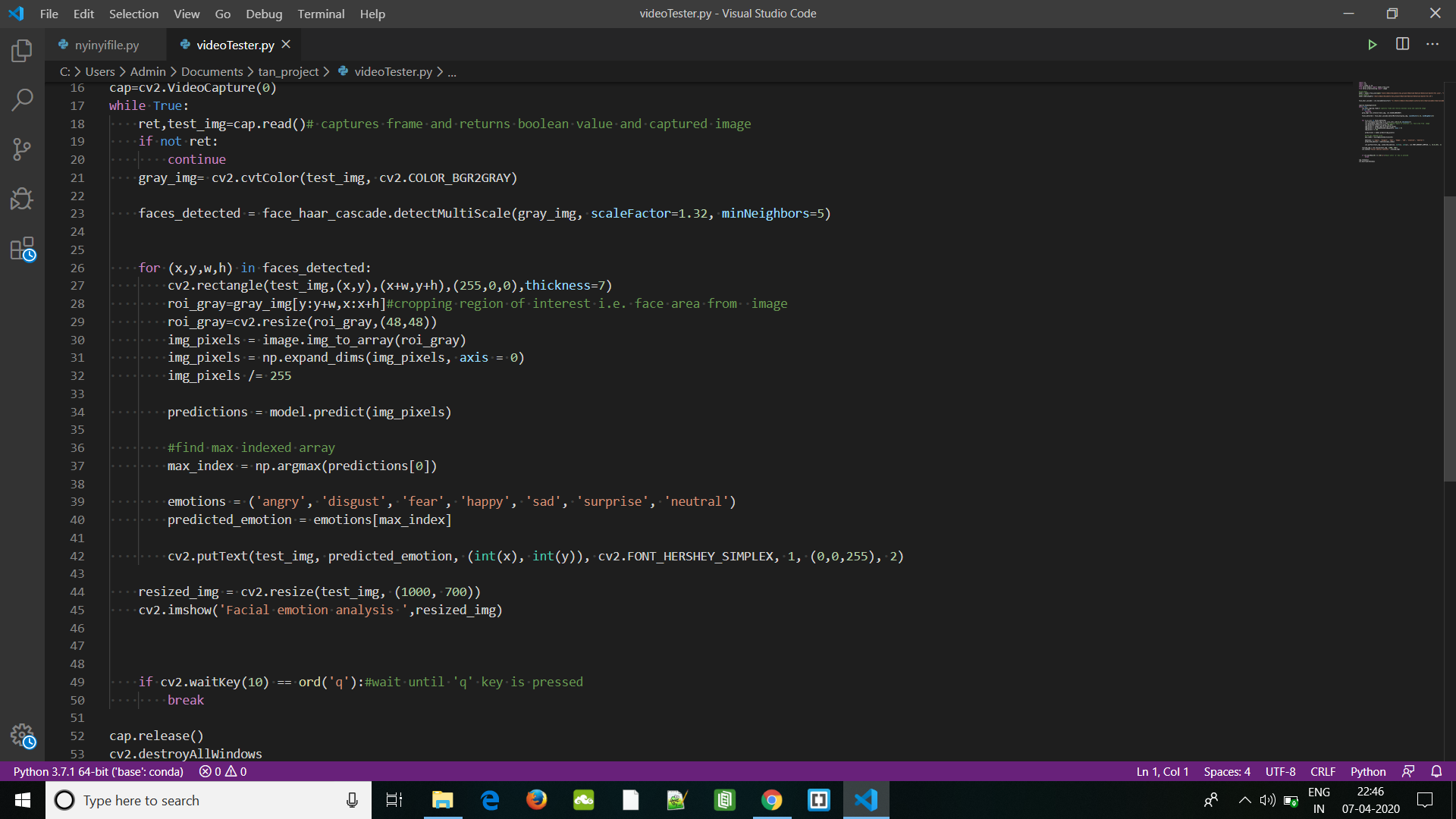

Slide 22
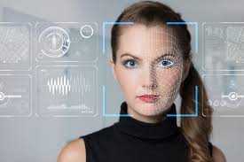
ScreenShots of Working Project-

Slide 23
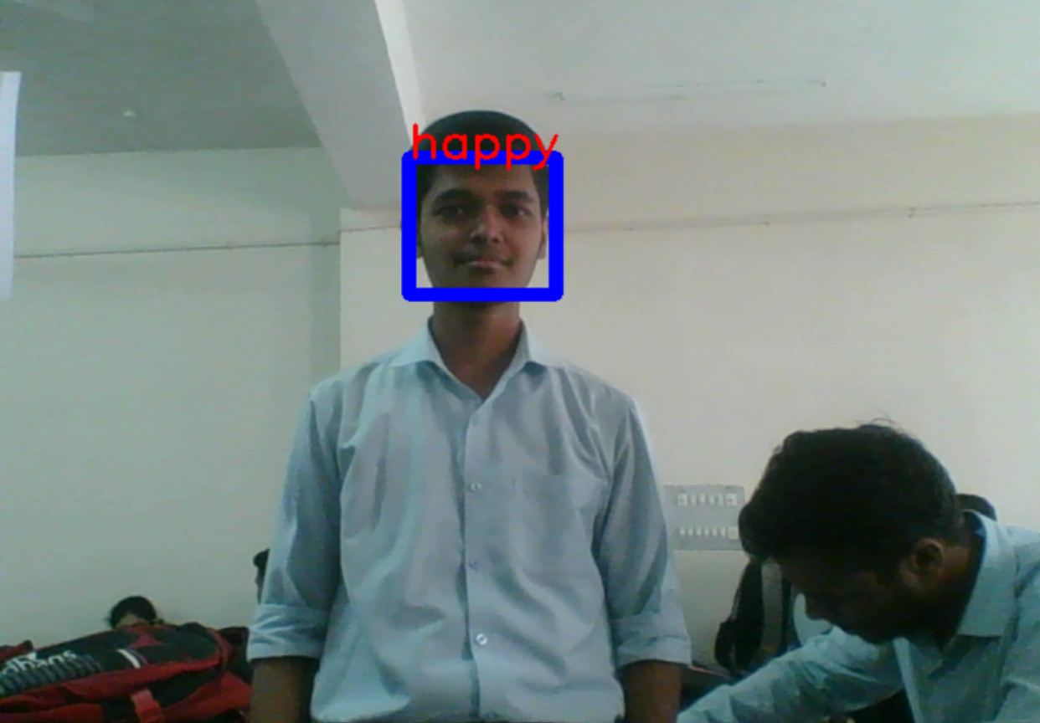

Slide 24
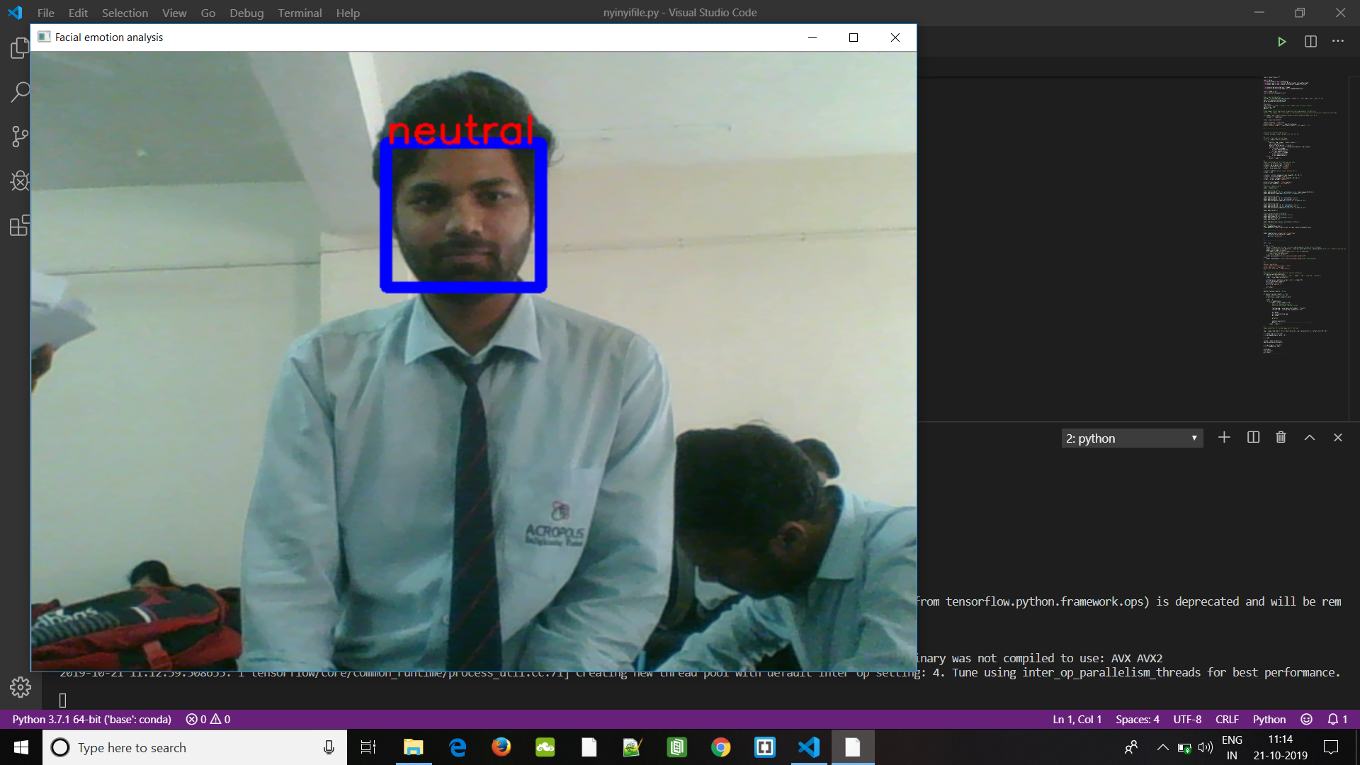

Slide 25
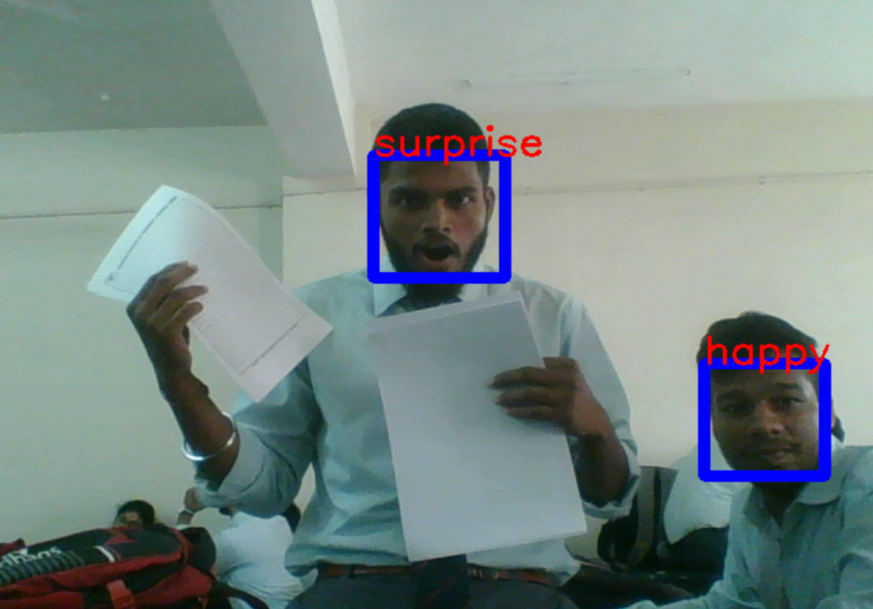

Slide 26
Challenges
The main purpose of this project is to detect various emotions in a given sample image. The most challenging part in this task is to determine the exact emotion when two emotions look quite similar, for e.g. “Disgust” being classified as “Sadness”, “Surprise” like “Happy” and so on. So, we must see how can we increase its efficiency and accuracy.
If we look at our emotions list we can find out that we have only limited number of examples for “sad”, “fear” and “contempt”. By increasing the number of images for these emotions we can certainly increase optimization, or if we no longer consider these emotions in the list then optimization can be increased more than 80%.

Slide 27
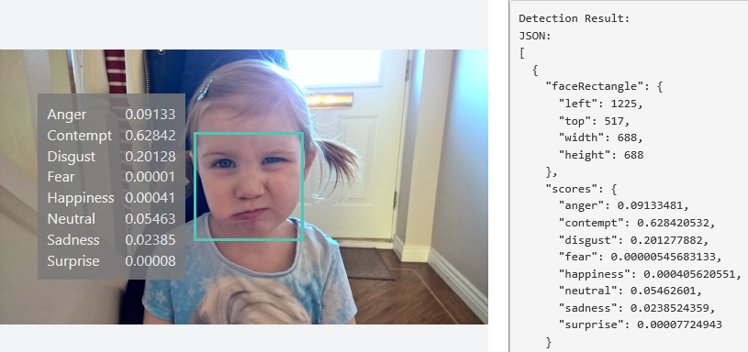
CONCLUSION AND FUTURE SCOPE

Slide 28
App and product development
Emotion recognition can play a huge role in optimizing various software engineering processes which comprises of testing of ease with which a product can be used. It’s a long established fact that level of comfort with different software products depends hugely upon human emotions. A products overall look and feel can also alter human feelings which in turn makes the person buy the product or not. Thus, researching about different emotional states of a human body and how it is influenced by usage of different products is a matter of prime importance for related industry professionals.

Slide 29
Improved learning practices
Evidence suggests that part of emotional states vouches for better learning practices while the other part try to suppress them. The difference between the two groups possessing different emotional states is not so common to find. For example, positive emotional state is thought to be bad for learning purposes while slightly negative emotional state fosters analytical thinking and is also appropriate for carrying out critical tasks.

Slide 30
Improvised Web Development
With the mammoth scale at which the internet is expanding, service providers are interested in collecting tons and tons of data which can be extracted from the users. Correspondingly, all the content and advertisements are played based on the users’ profile. Subsequently, adding intricate details about the different human emotions can provide much more precise behavioral models of different types of users.

Slide 31
Immersive Gaming
Video games constitute a large chunk of entertainment industry. Thus, in order to make these games much more intensive and intrusive, video game creators base their research on different types of human emotions commonly found. In order to allure more and more players, video games are made in such a way that they incorporate human emotions naturally into their game play.

Slide 32
References
Wikipedia- Artificial Neural Netwok & Convoluted Neural Netwok
Omar Ayman,Emotion Analysis,github-https://github.com/omar178/Emotion-recognition,2016.
Facial Emotion Detection using CNN and Representional Autoencoders Units By Prudhvi Raj Dachpally,School of Informatics and Computing,Indiana University.
Facial Expression Recognition using a neural network by
Christine Lisetti,Florida International University.

Slide 33
Thank
You!

